Slide 1
Team AA
By: Richa Israni, Abhay Sawhney,
Elisabeth Vehling, & Nathan Van Lare

Slide 2


Target Persona (Student Sally)
Challenges:
work-life balance
living on their own
social media presence
Description:
Aspirational
lower 25% income
trying to make parents proud
stable income/life
make parents proud
Fears:
failure
dropping out of college
not getting a job
Notes:
Image source:-
https://pixabay.com/en/technology-industry-big-data-cpu-3092486/

Slide 3
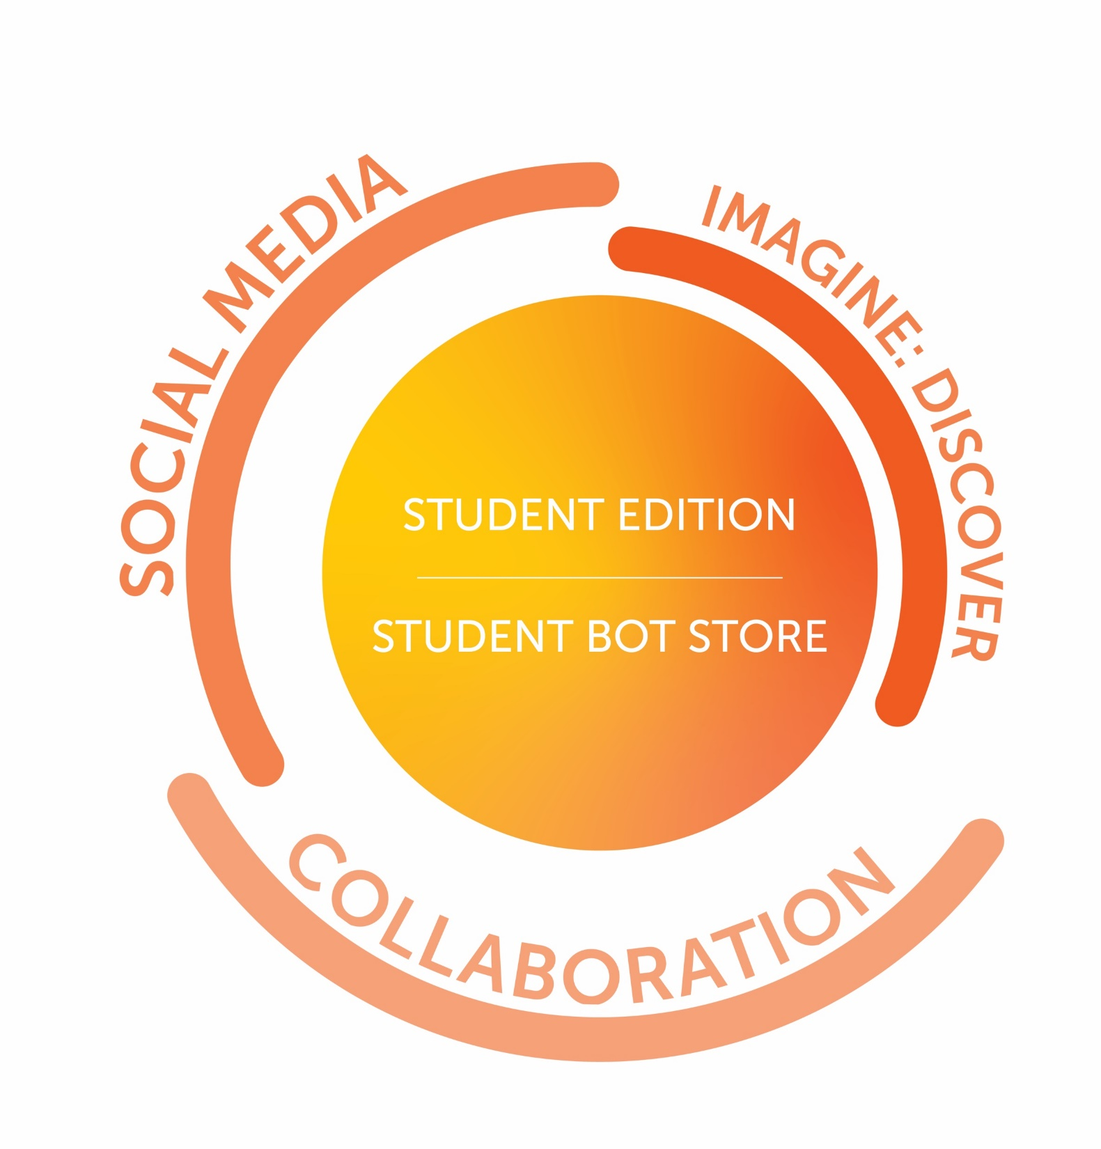

Slide 4

WHAT?

Slide 5
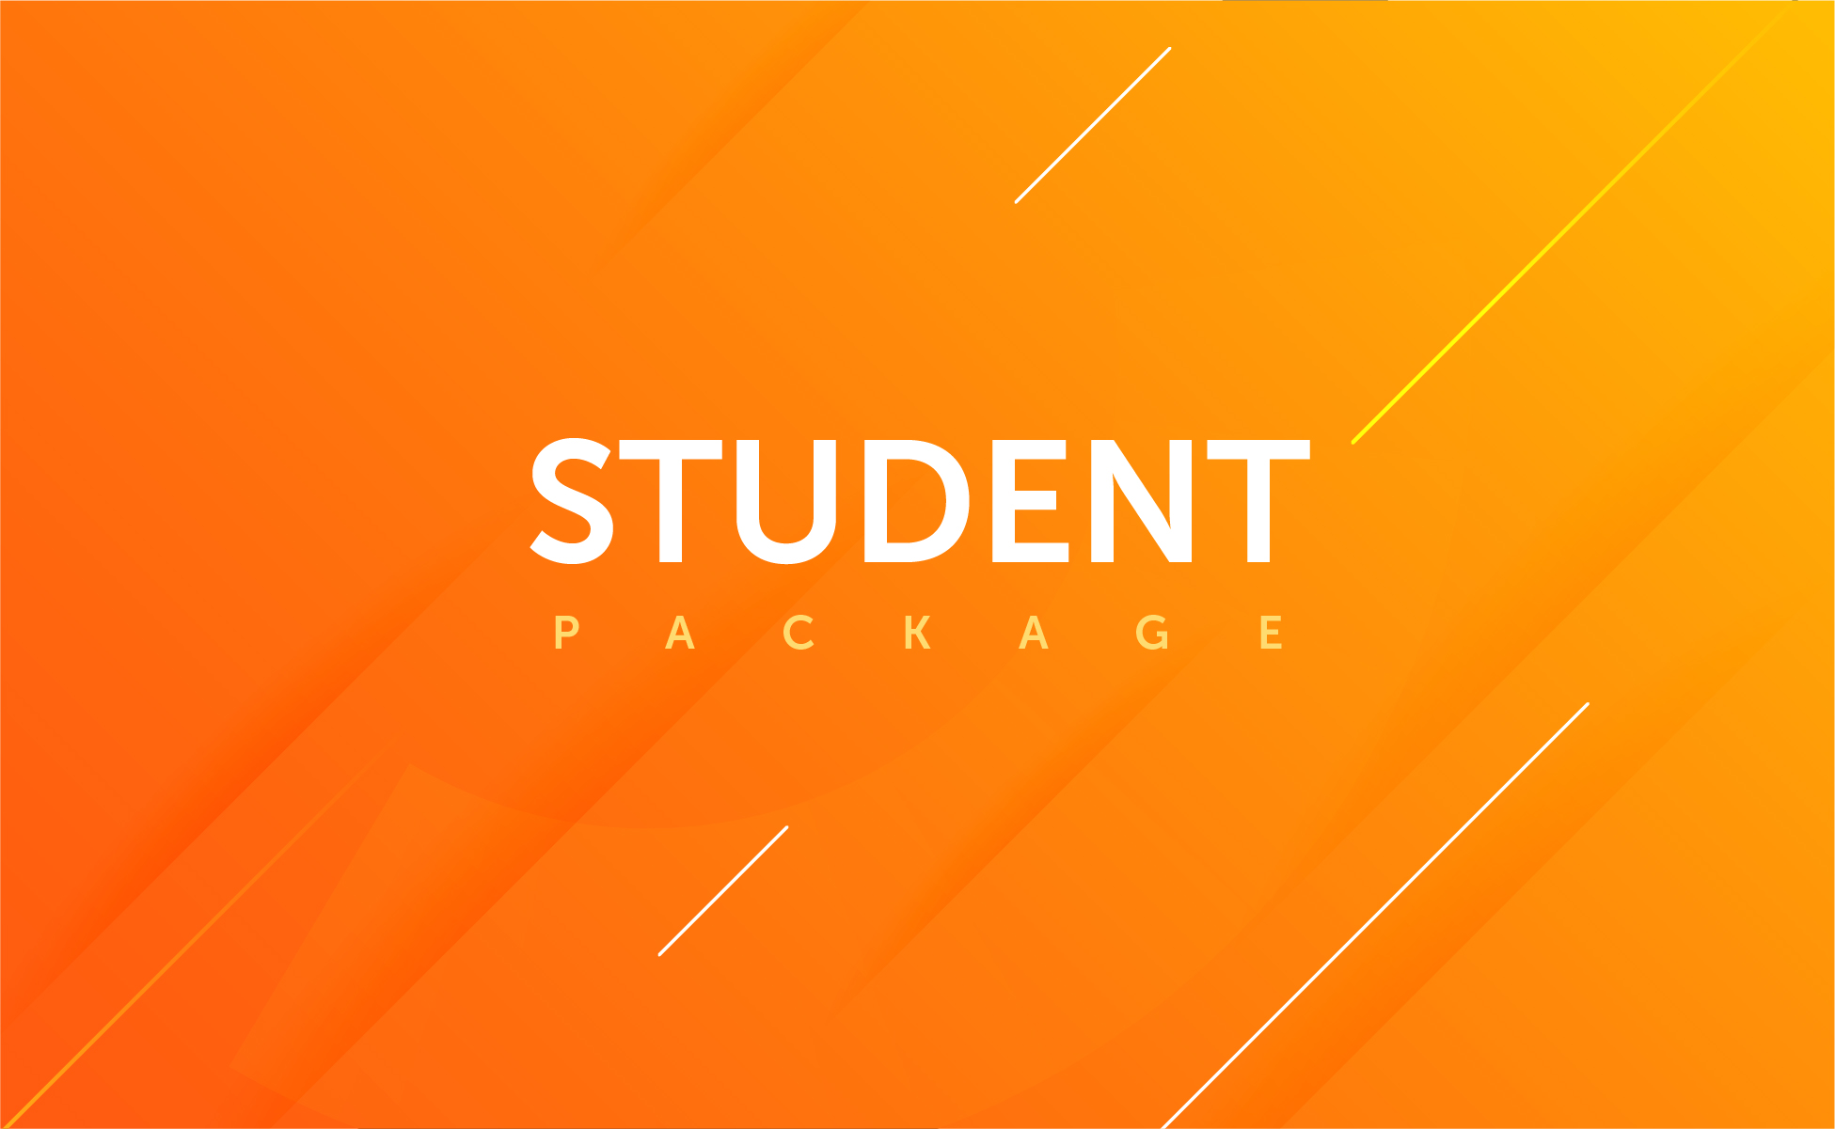
Notes:
Pre built bots optimized for student usage

Slide 6
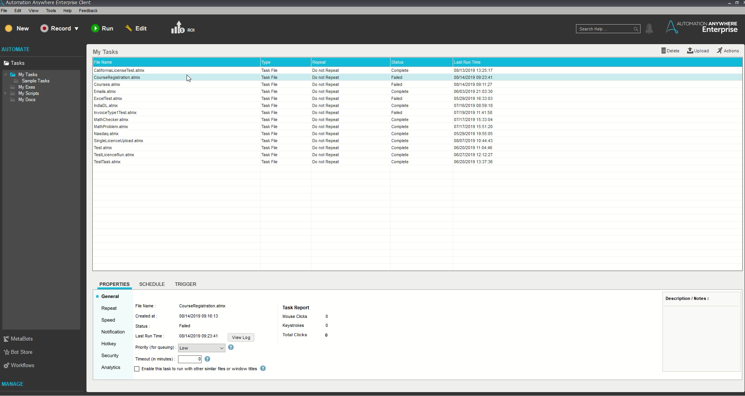

Slide 7
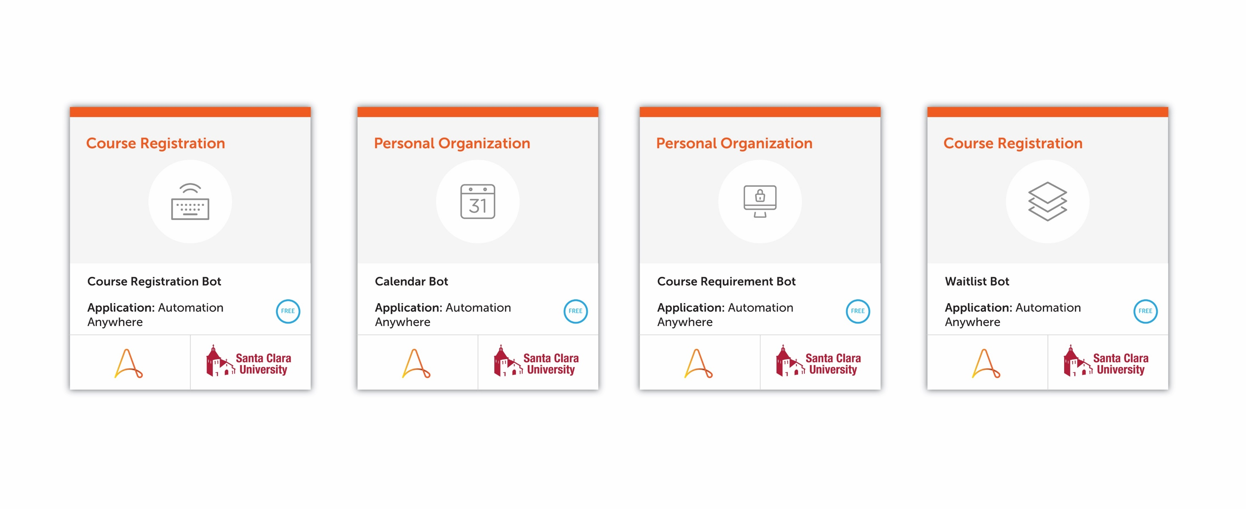
Student Bot Store

Slide 8
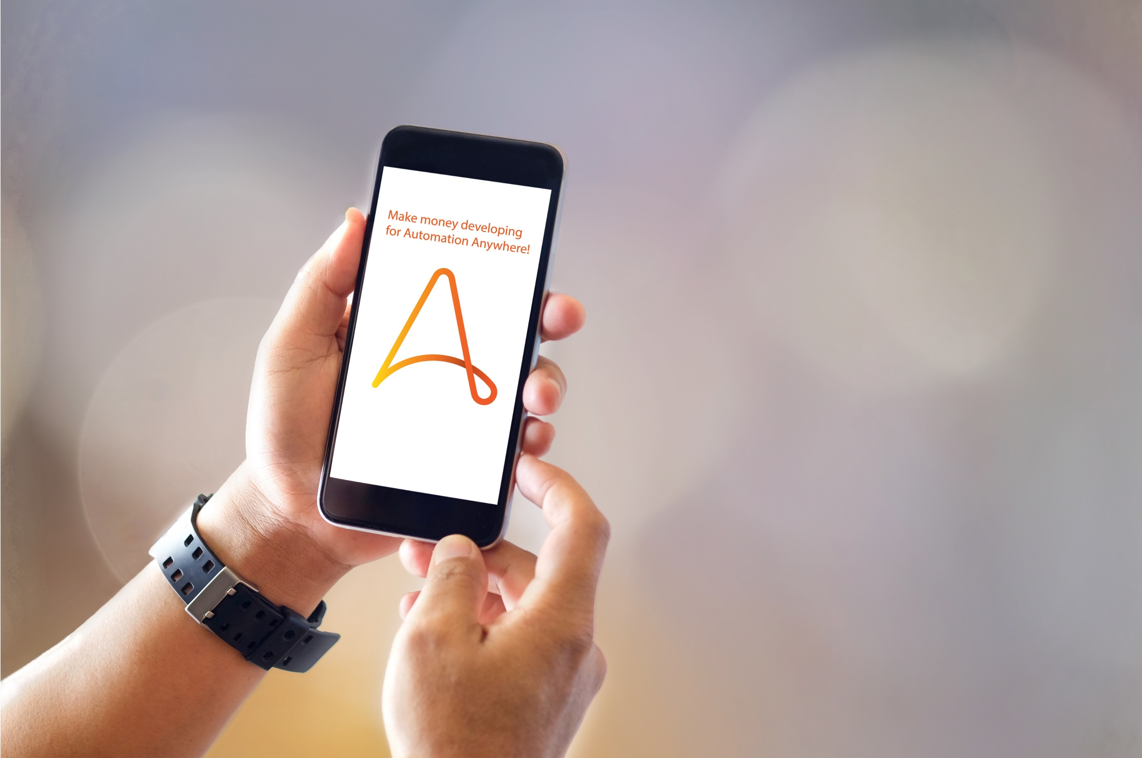
Monetization

Slide 9

HOW?

Slide 10


Slide 11
BENEFITS TO COLLABORATION
Direct access to Office 365’s 180 million user base
Pre-existing:
Relationship and partnership with Microsoft
Integration with Office 365

Slide 12


Slide 13




MARKETING: SOCIAL MEDIA
INSTRUCTIONAL
PROFESSIONAL
BRAND
EVERY DAY

Slide 14
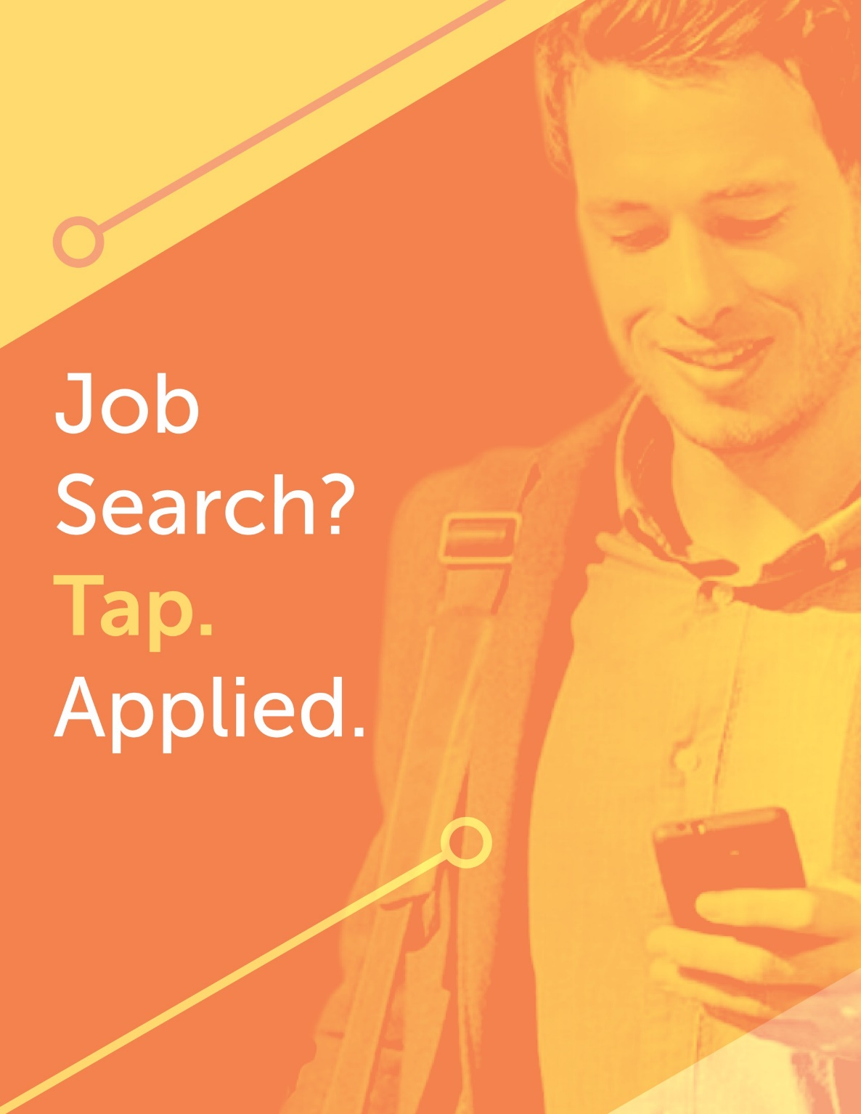
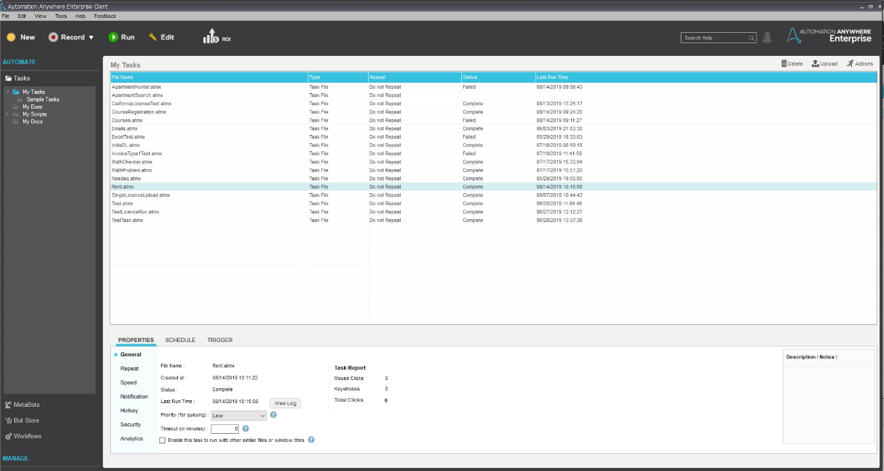


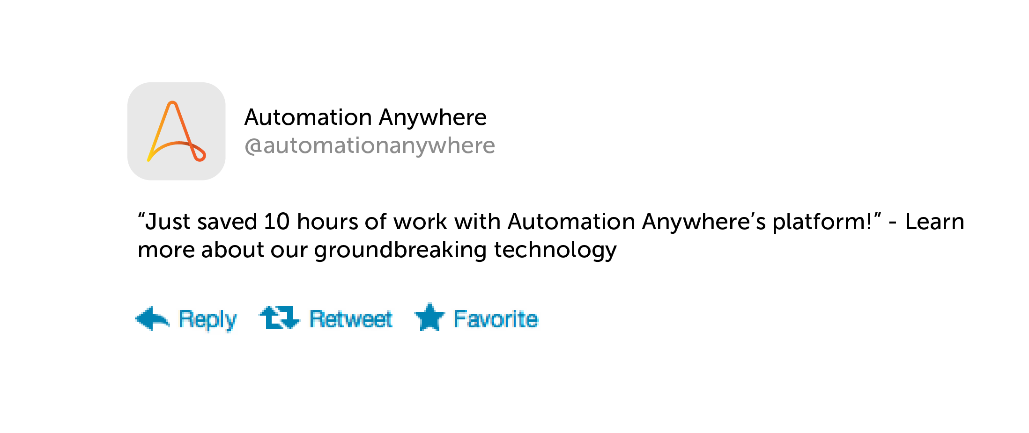

How to build your first bot

Slide 15
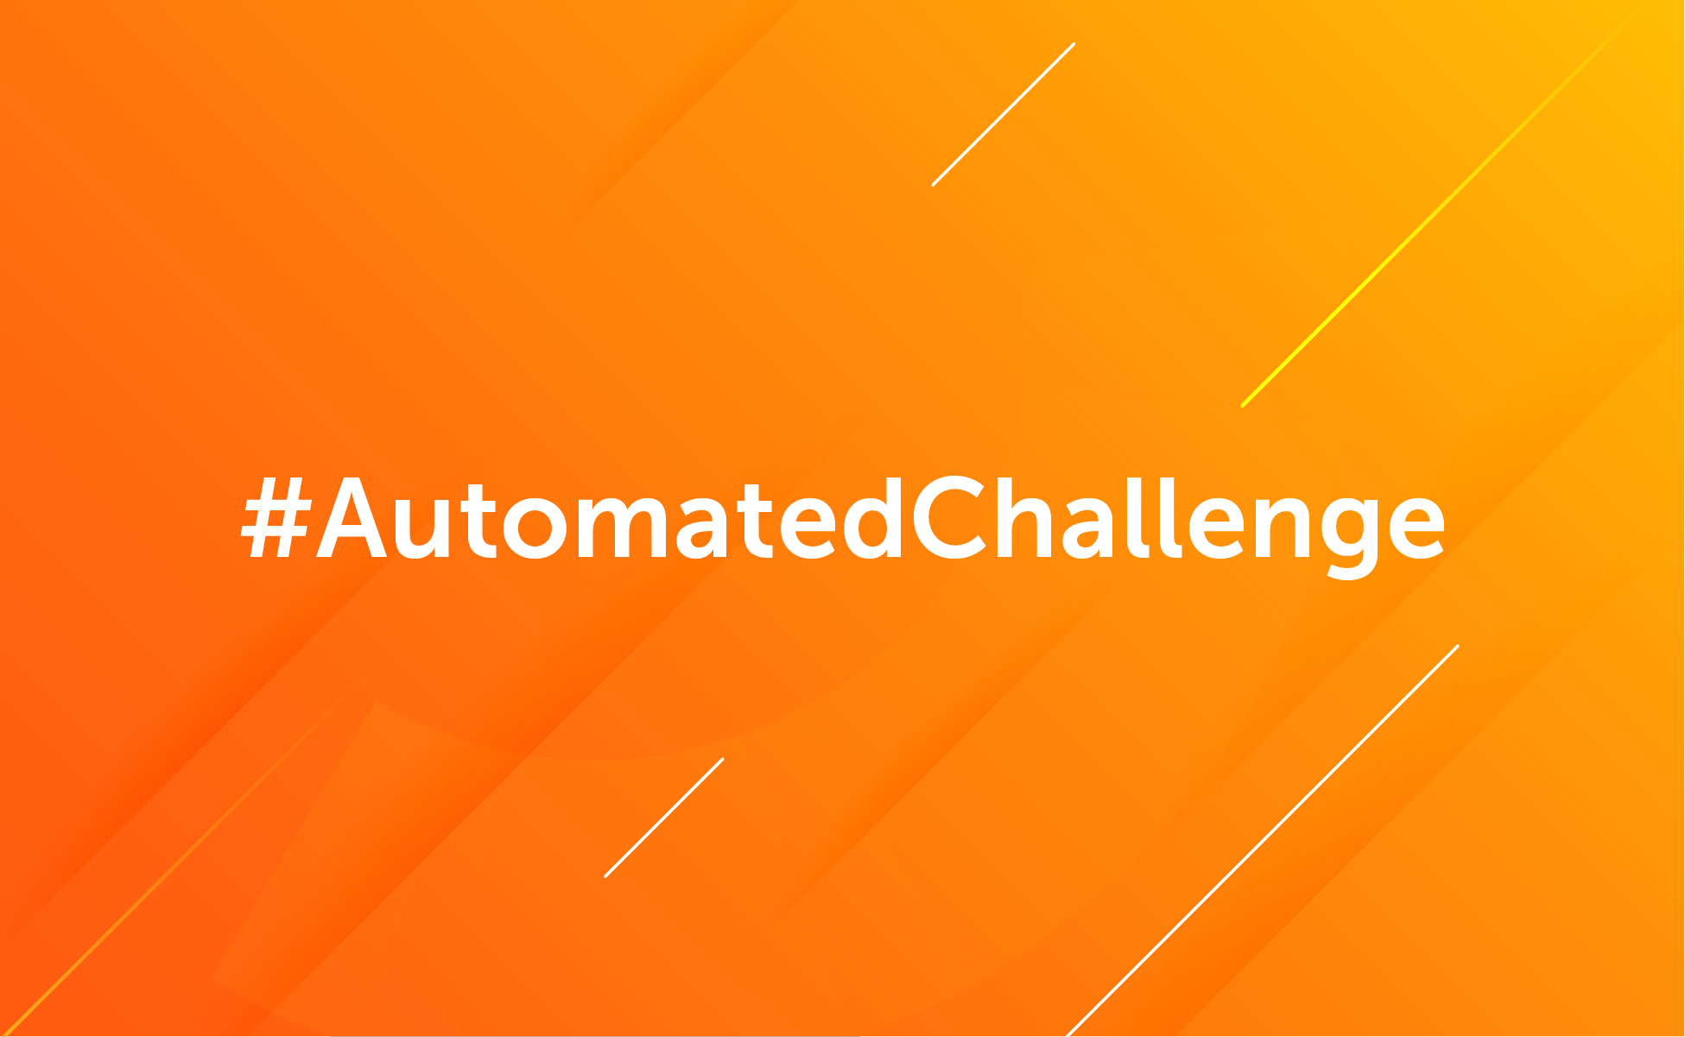

Slide 16

Notes:
Imagine Discover

Slide 17
IMAGINE: DISCOVER
Integrate student component into Imagine
Partnership with CS student groups
Reward top 10 RPA students nationwide
Potential for dedicated student conference in the future

Slide 18
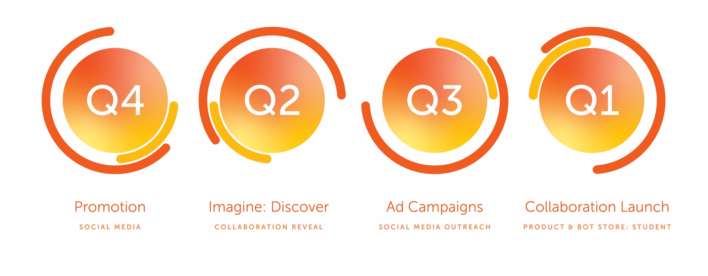
Timeline

Slide 19
SUCCESS METRICS
KPIs measuring
Increase in CE installs
Bot store accounts created
.edu emails registered
Goals:
10% YOY growth in overall installs
25% YOY growth in “.edu” installs

